Slide 1

2017 Patient Safety Forum
March 30, 2017
Jointly provided by:
Massachusetts Coalition for the Prevention of Medical Errors
and
Healthcentric Advisors

Slide 2


Many thanks to our
Proposal Review and Planning Committees
Ann Burke RN,CPHRM
Director, Risk Management
Coverys
Yvonne Cheung MD, MPH, CPPS
Chair, Department of Quality and Patient Safety
Mount Auburn Hospital
Pat Folcarelli PhD, RN
Interim Vice President, Health Care Quality and Safety
Beth Israel Deaconess Medical Center
Linda Kenney
President/Executive Director and Founder
Medically Induced Trauma Support Services
Carol Keohane MS, RN
Assistant Vice President, Patient Safety
CRICO
Patricia Noga PhD, RN, MBA, NEA-BC
Vice President, Clinical Affairs
Massachusetts Health & Hospital Association
Annette Roberts BSN, RN
Director of Performance Improvement and Quality
Milford Regional Medical Center
Terry Sievers MS, RN, CPHQ, CPHRM
Vice President, Quality, Risk Management & Patient Safety
Hallmark Health System

Slide 3
Learning Objectives
As a result of participating in this forum, learners will be able to:
Describe barriers to improvement efforts in healthcare, and implications for accelerating improvement
Describe the Framework for Clinical Excellence, including the elements of Leadership, Culture, Learning Systems, and Patient & Family Engagement
Identify factors that create risk to patients in care processes, and describe effective patient safety improvement strategies to address them.
Discuss the emotional harm to patients and families, and to clinicians and staff involved, after adverse events, and approaches to provide support and healing to overcome this harm.

Slide 4
Disclosure statement
This notice confirms that there were not relevant conflicts of interest reported from either the event’s speakers or planning members of this learning activity.

Slide 5

Accelerating Improvement in
Quality and Patient Safety
Patient Safety Forum 2017
March 30, 2017
Terry Sievers, MS, RN, CPHQ, CPHRM
Massachusetts Coalition to Prevent Medical Errors
And Hallmark Health System

Slide 6
Integrating Performance Improvement - Goals
All dimensions of quality including
Safety
Patient centeredness
Affordability
Across settings /integrated systems – ACOs
Care transitions
Population health
And crucially – caring for the workforce
Worker safety
Reduce overload/burnout
Engagement → joy and meaning in work

Slide 7
Accelerating Improvement
Focus of Today’s Forum is on How
Our keynote speaker, Jim Conway will provide a comprehensive overview of the compelling reasons why improvement is needed and insight into the reasons we have not seen the amount of improvement desired
It comes down to …exactly how can improvement be accelerated within complex healthcare environments that have numerous competing challenges and competing demands for scarce resources

Slide 8

Strategies for Accelerating Improvement
Leadership
Culture
Robust Process Improvement and Learning Strategies
Patient and Family Engagement

Slide 9



Frameworks for
Clinical Excellence, High Reliability and Value
Framework for Safe, Reliable & Effective Care | Framework for High Reliability | Value Framework
Leadership | Leadership | Leadership
Culture | Safety Culture | Culture
Learning System | Robust Process Improvement Learning Organization | Systems Approach to Improvement (Measurement & Improvement Capability)
Patient and Family Engagement |  | Learning Organization

Slide 10
Framework for High Reliability
Identified changes in 3 overarching areas
Leadership
  Commitment to achieve zero patient harm
  Culture of Safety
  Fully functioning throughout the organization
  Robust Process Improvement
  Widespread deployment of highly effective improvement tools

Slide 11
High Reliability Framework
Leadership “Foundation” | Safety Culture “The Glue” | Robust Process Improvement “The Engine”
Board: Commits to high reliability/zero harm CEO/Management: Aims for high reliability/zero harm Physicians: Routinely lead QI activities and have uniform participation Quality Strategy: Quality is the highest-priority strategic goal Transparency: Quality measures are routinely displayed internally and publicly; reward and recognition for quality accomplishments Information Technology: Safely adopt IT & use to sustain improvement Organizational commitment: is demonstrated by resources | Trust: High levels of (measured) trust; self-policing codes of behavior Accountability: All staff recognize and act on personal accountability for safety; equitable and transparent disciplinary procedures Identify Unsafe Conditions: all are empowered to identify safety issues, leads to problem resolution; shared results System Defenses: proactively assessed, and weaknesses are proactively repaired Safety Culture is Assessed: Safety culture measures are strategic metrics reported to the board Systematic teamwork improvement: initiatives in place | Methods: Adoption of RPI tools throughout the organization ID Methods: Change management, Lean, Six Sigma and PDCA Investment in Training: RPI training is mandatory for all staff, as appropriate to their jobs Spread: RPI tools are used throughout the organization for all improvement work; Patients and families are engaged in redesigning care processes, and RPI proficiency is required for career advancement
RPI
Safety Culture
Leadership

Slide 12
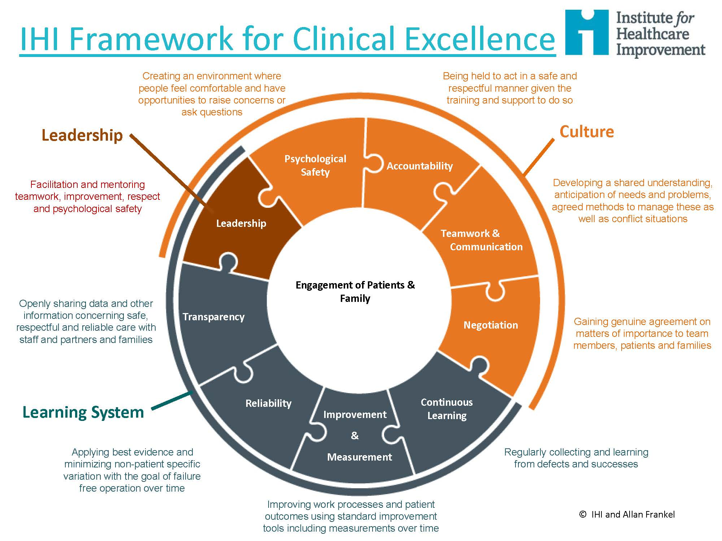
IHI Framework for Safe, Reliable and Effective Care

Slide 13
Leadership
  Leaders identify key improvement opportunities and prioritize them to align with broader strategic goals
  Culture
  Senior leaders and frontline teams actively engage in continually improving care
  Systems Approach to Improvement
  Organizational processes are mapped are mapped across functions and departments
  Measurement Capability
  Outcomes and process data are displayed as current, time-trended information
  Learning Organization
  Reflected in the spread of effective practices
  Improvement Capability
  Sustained improvement is effected through oversight, an infrastructure of expertise, and an identified training methodology

Slide 14
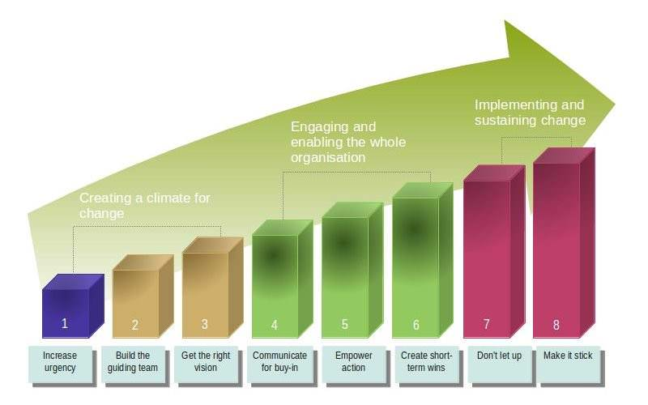
Models for Change Management
Kotter’s Eight Steps of Change
Prosci’s ADKAR Model for Change
Awareness
Desire
Knowledge
Ability
Reinforcement
Lewin’s Model for Change
Unfreeze
Change
Refreeze

Slide 15

Resources for improvement and sustainability?
Personnel:
  Accreditation, quality, risk management, patient advocates, performance improvement
  Data and quality system analysts, report writers and programmers
  Align reporting for increased collaboration and decreased redundancy of resources
  Co-locate personnel for increased collaboration
Analytic Tools
  Software: incident reporting, AHRQ quality indicators, data repository, data visualization tools, SAS statistical analysis tools
  Education:
    Quality and Risk personnel training
    Leadership, manager and workforce training
    Theory and methods of improvement
    Compassionate patient and family centered care
    Team Training
    Computers, EHR, data analysis
  Organizational Structure that supports accountability
  Organizational Culture:
    Just culture
    Use evidence based best practices

Slide 16


Game Plan
Executive, physician and clinical leadership
Know your data, provide the right level of data to the right audience
Identify and prioritize goals based on achieving high reliability for evidence based care, reducing harm, improving the patient experience and improving measures tied to pay for performance
Align and cascade goals
Focus improvement efforts
Educate the workforce in improvement theory and methods, patient experience, team training, just culture
Create an oversight and accountability structure and processes that support achievement of goals
Assign responsibility
Communicate achievements and opportunities for improvement

Slide 17
References
Chassin, M and Loeb, J (2013) High-Reliability Health Care: Getting There from Here. The Milbank Quarterly. V91, N3.
Scoville, R et al. (2016) Sustaining Improvement. IHI White Paper, Cambridge, MA
NPSF (2015) Free from Harm: Accelerating Patient Safety Improvement Fifteen Years after To Err is Human.
Schilling, L, et al. (2010) Kaiser Permanente’s Performance Improvement System, Part 1: From Benchmarking to Executing on Strategic Priorities. JCJQPS V36, N11.
Schilling, L, et al. (2010) Kaiser Permanente’s Performance System, Part 2: Developing a Value Framework. JCJQPS V36, N12.
Whippy, A, et al. (2011) Kaiser Permanente’s Performance Improvement System, Part 3: Multisite Improvements in Care for Patient’s with Sepsis. JCJQPS V37, N11.
Schilling, L, et al. (2011) Kaiser Permanente’s Performance Improvement System, Part 4: Creating a Learning Organization. JCJQPS V37, N12.
Berwick, D, (2016) Era 3 for Medicine and Health Care. JAMA. V315, N13.

